Slide 1

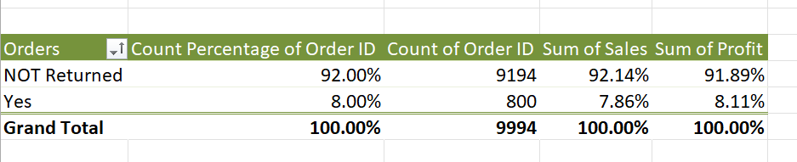
Q1
1)Insights- the return wer 2.97 percent
2)Formula-=used Xlookup and
And rest is done using pivot table
3)Inference – First I have created and calculated the avg time column Then select all the data created pivot table and calculated the answer .

Slide 2
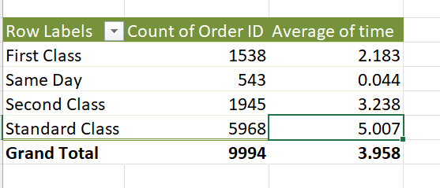
Q2
1)Insights- Standard class has the slowest delivery and the first class has the fastest delivery
2)Formula-=[@[Ship Date]]-[@[Order Date]] for time column
And rest is done using pivot table
3)Inference – First I have created and calculated the avg time column Then select all the data created pivot table and calculated the answer .

Slide 3
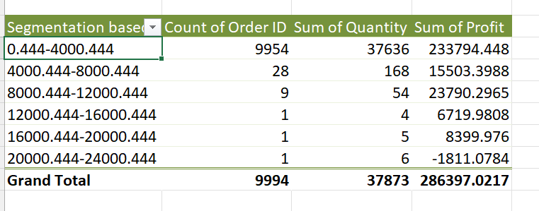
Q3
1)Insights-The Most Valuable Customer Segment is the first group of 0.444-4000.444 in terms of profitability and count of orders and quantity
As shown in the picture above
2)Formula-First done grouping by 4000 of the sales and created the groups and rest is done using pivot table

Slide 4
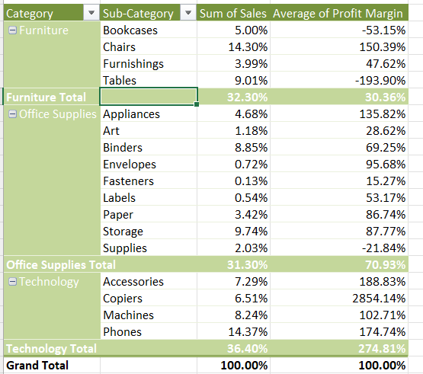
Q4
1)Insights-The top selling category is Technology and the top selling subcategory is Phones
As shown in the picture on the left
2)Formula-First created pivot table and then all the calculations are done with the pivot table including percentage and grand totals .

Slide 5
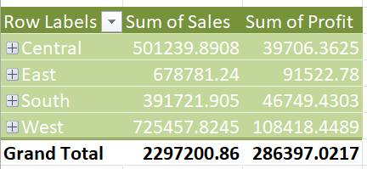
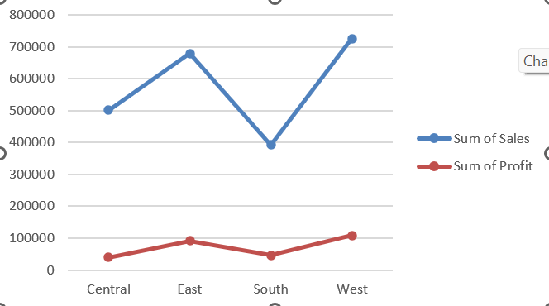
Q5
1)Insights-Region with highest sales is West Region
Region with Lowest Sales is South Region
Yes the Regional trends affects the profitabliliy directly as it shown in the above figure that both trends show very similar behaviour
2)Formula - First created pivot table and then all the calculations are done with the pivot table including Sum of Sales and Profit after creating the pivot table I have created the chart to see the trends .

Slide 6
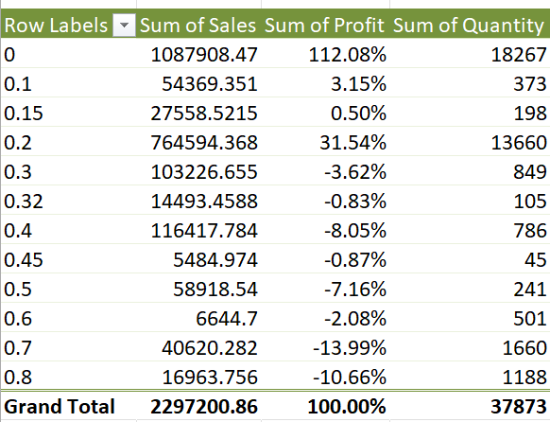
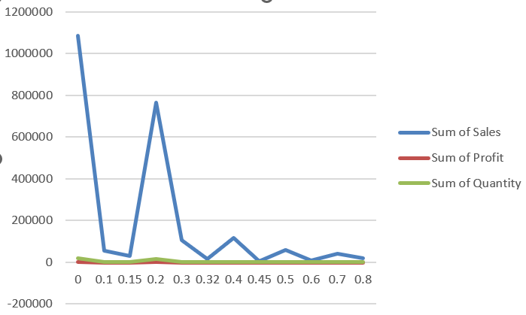
Q6
1)Insights-There is so much impact of discounts on the sales but not on profit as you can see the above pictures these insights are calculated .
2)Formulas used = =CORREL(Table1[Discount],Table1[Quantity])
=CORREL(Table1[Discount],Table1[Profit])

Slide 7
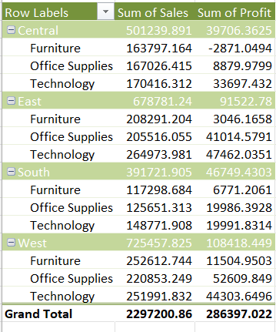
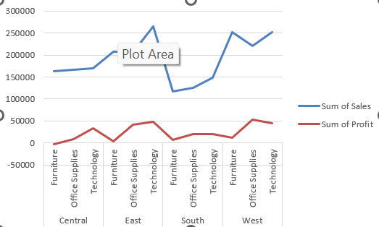
Q7
1)Insights-Region which has low market saturation is South Region
As you can see but the potential market growth capacity of technology sector the South Region has is also huge
Yes the Regional trends affects the profitabliliy directly as it shown in the above figure that both trends show very similar behaviour
2)Formula - First created pivot table and then all the calculations are done with the pivot table including Sum of Sales and Profit after creating the pivot table I have created the chart to see the trends .

Slide 8
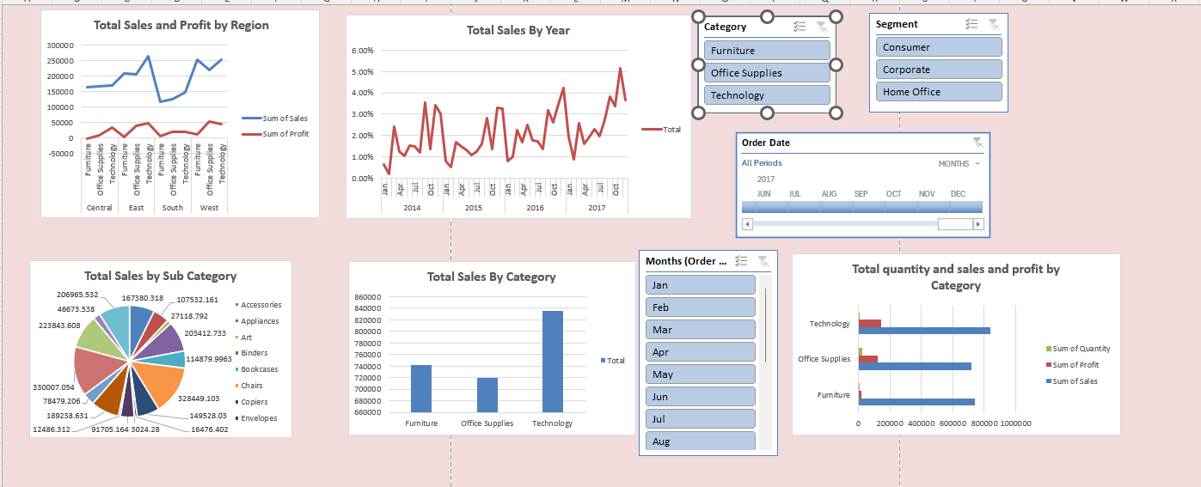
Q9

Slide 9
Q9

Slide 10
Q10

Slide 11
Q11

Slide 12
Q12

Slide 13
Q13

Slide 14
Q14

Slide 15
Q15

Slide 16
Q16

Slide 17
Q17

Slide 18
Q18

Slide 19
Q19

Slide 20
Q20

